Slide 1
From Guesswork to Ground Truth: RAG in Action
How Retrieval-Augmented Generation Solves Hallucinations
Advika Thakur | Workplace Engineering | Summer Analyst

Slide 2
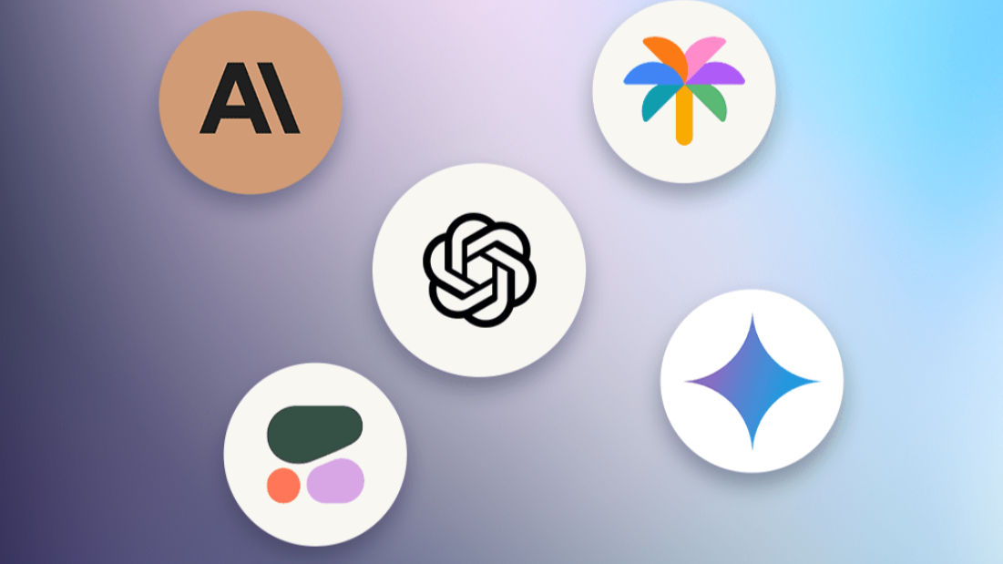
Large Language Models

Slide 3
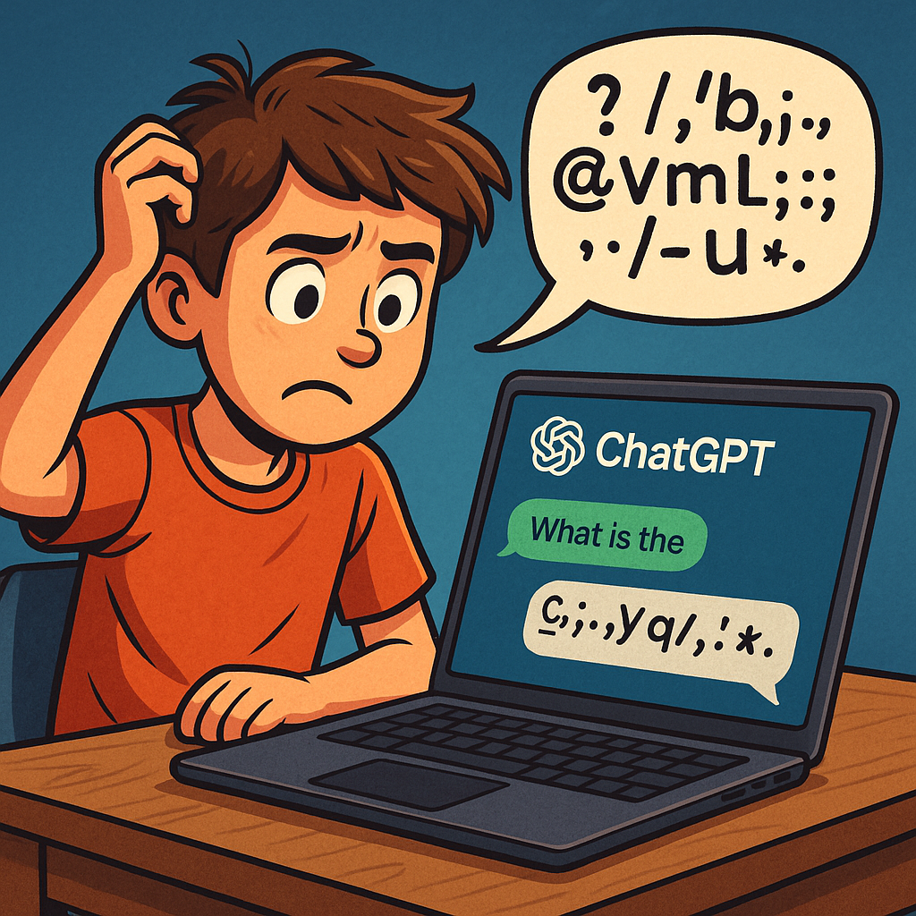
What are hallucinations in LMS?
In the context of Large Language Models (LLMs), hallucinations refer to the phenomenon where the model generates outputs that are factually incorrect, nonsensical, or not grounded in the provided input or training data. Essentially, it's when the AI makes things up, presenting false information as if it were true.

Slide 4
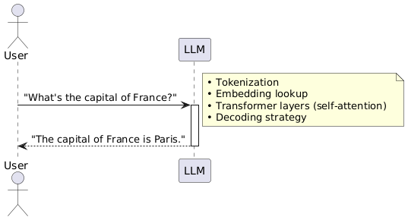
LLM Query–Response Cycle (Simplified)
User: Sends a text-based question into the model.
LLM: Processes your input using patterns learned during pre-training and returns
A fluent, human-like answer back.
(Note: The model’s knowledge is static—it can’t verify facts in real time.)

Slide 5


There are a couple of key issues with how general-purpose LLMs answer questions:
Lack of source attribution
Outdated information

Slide 6
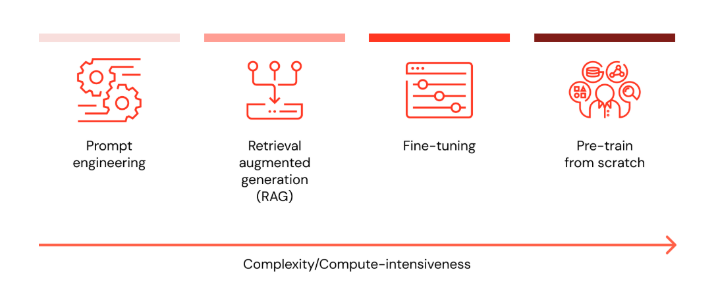
I want to customize my LLM with data, what are all the options

Slide 7
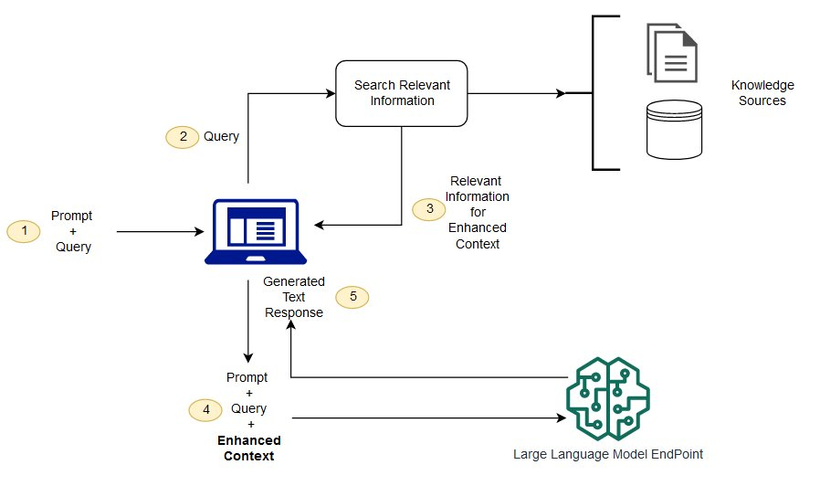
Retrieval Augmented Generation
RAG (Retrieval-Augmented Generation) is an AI framework that combines the strengths of traditional information retrieval systems (such as search and databases) with the capabilities of generative large language models (LLMs). By combining your data and world knowledge with LLM language skills, grounded generation is more accurate, up-to-date, and relevant to your specific needs.
-Definition By Google
First proposed by Facebook AI in the 2020 paper: Retrieval-Augmented Generation for Knowledge-Intensive NLP Tasks Link to paper (arXiv)

Slide 8
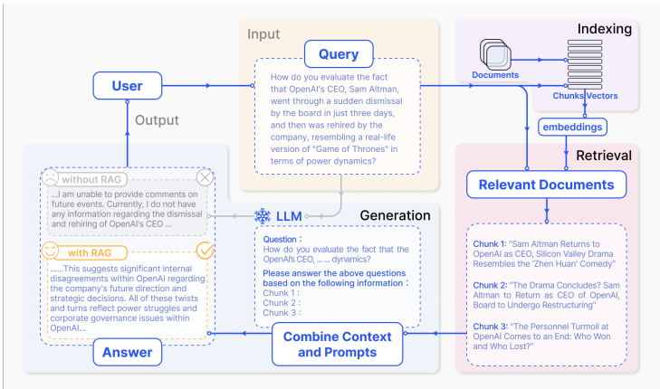
We are referring this paper to understand RAG
https://arxiv.org/pdf/2312.10997

Slide 9
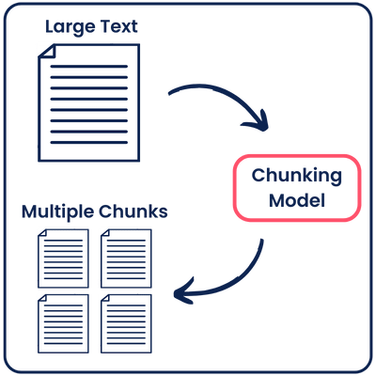
Chunking Strategies
What is Chunking?
Splitting long documents into smaller, coherent pieces (“chunks”)
Keeps each piece within embedding/LLM token limits
Preserves context so retrieval remains meaningful
Common Chunking Strategies
Fixed-Size Splitting
Break text into chunks of N tokens or characters (e.g. 500–1,000 tokens each)
Simple but may split mid-sentence
Sliding-Window
Create windows of N tokens with M-token overlap (e.g. 500-token window, 100-token overlap)
Overlap ensures context continuity across boundaries

Slide 10
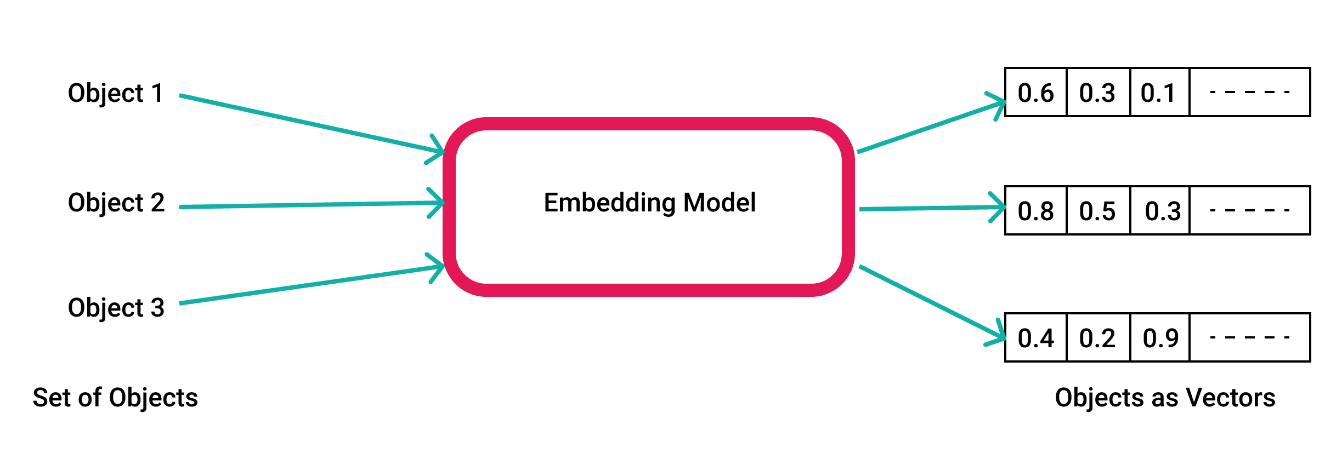
Vectorizer
A vectorizer is a model that maps text to vectors in a high-dimensional embedding space so that semantically similar texts end up close together. For RAG, we use vectorizers that are built on BERT or its variants, because they produce contextual embeddings (i.e., the meaning of a word changes based on its surroundings).

Slide 11
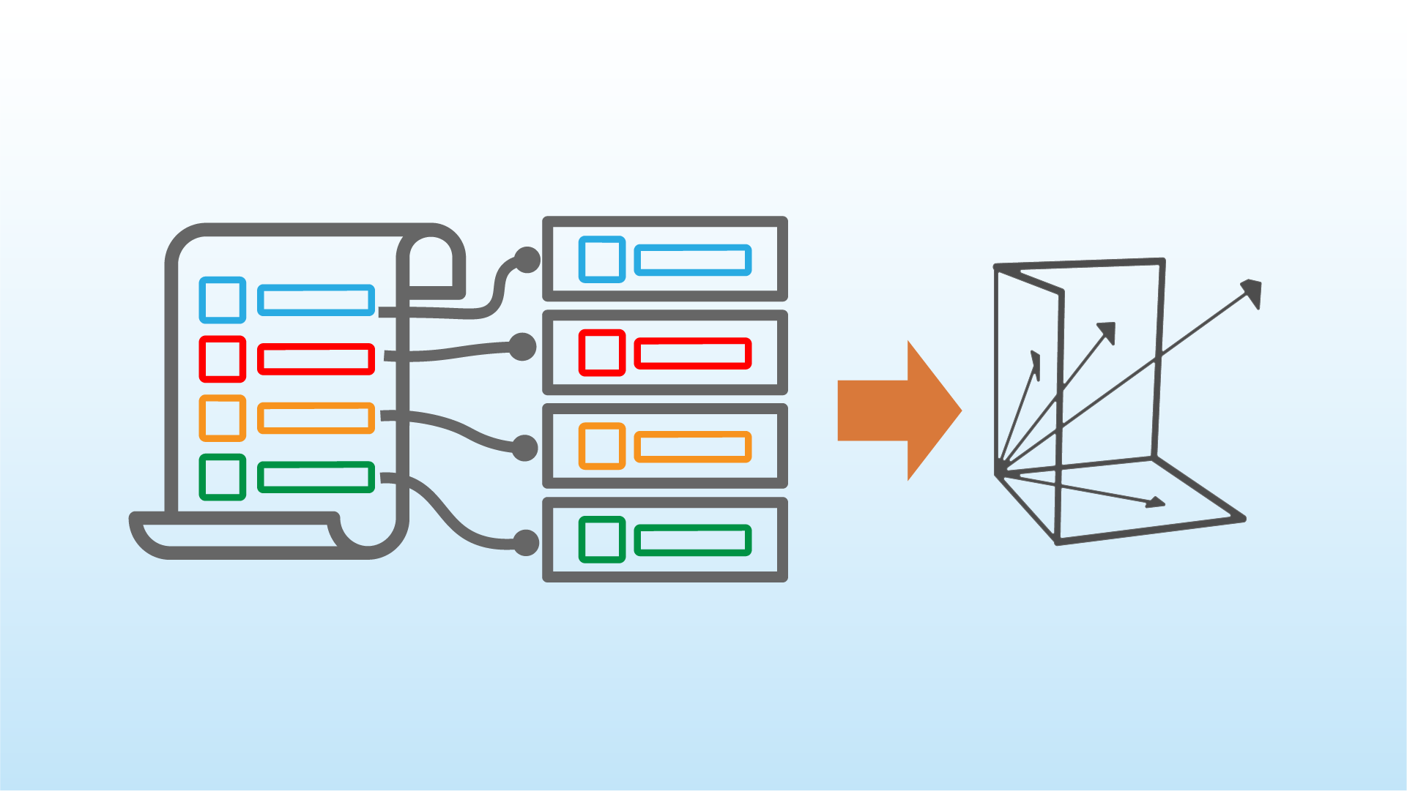
Embedding Space
The embedding space is a high-dimensional mathematical space where pieces of text are represented as vectors.
Each vector might have 128, 256, 768, or even more dimensions, depending on the embedding model used.
Think of it like a semantic map: the more similar two pieces of text are in meaning, the closer their vectors will be in this space.
For example:
“dog” and “puppy” will appear close together.
“banana” and “server logs” will be far apart.

Slide 12
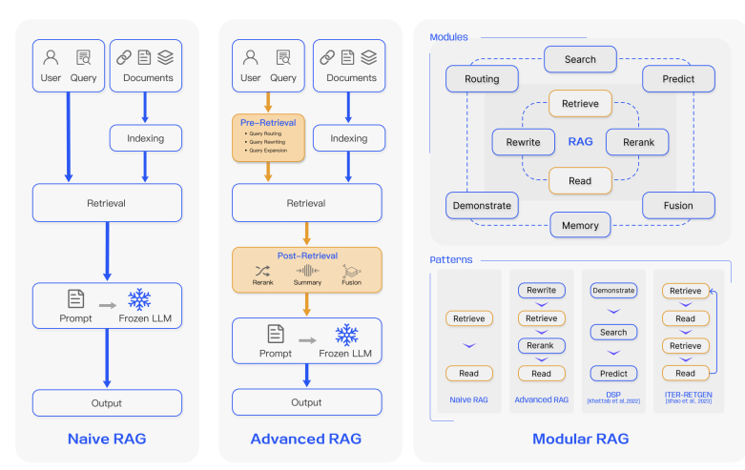

Slide 13
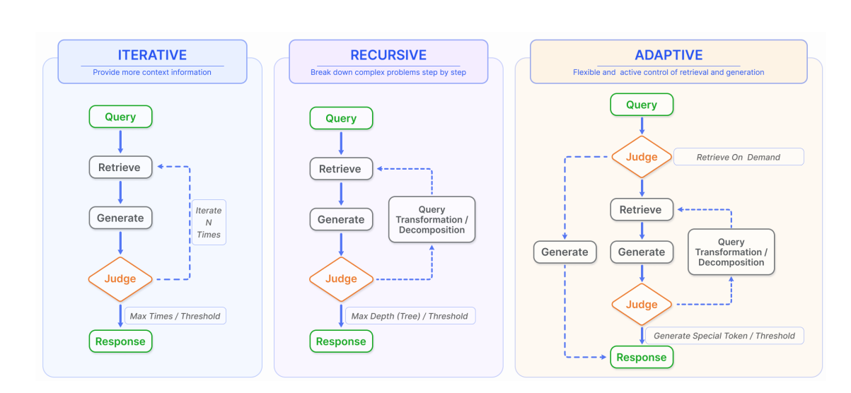

Slide 14
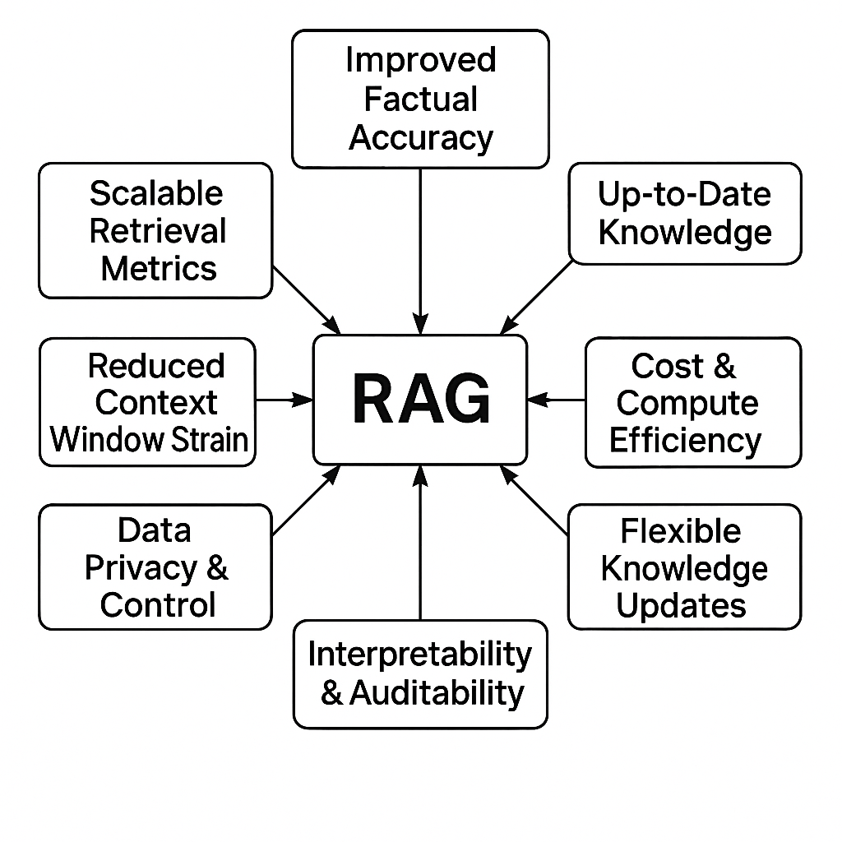
RAG’s core benefits

Slide 15
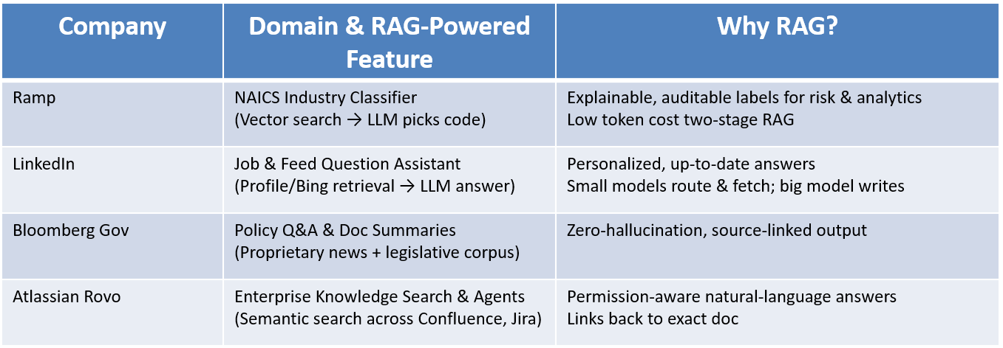
RAG in Industry

